Slide 1
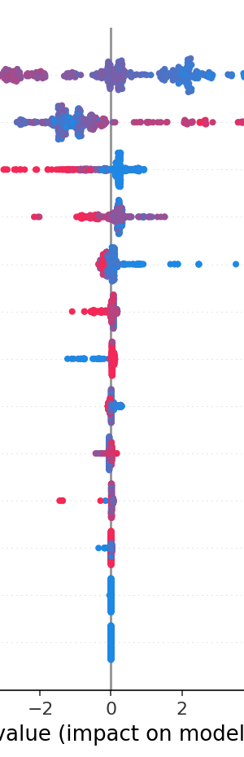
SHAP (SHapley Additive exPlanations)
An introduction to the
SHAP Library

Slide 2

ABOUT ME
Data Scientist
Microsoft
Virgin Media
383
Penguin Random House

Slide 3
TODAY’S TALK
- Problem Space
Introduction to SHAP
Getting Started
Conclusion

Slide 4
PROBLEM SPACE

Slide 5
PROBLEM SPACE

Slide 6
INTRODUCTION TO SHAP
Notes:
SHAP came out of the AIMS Lab in Washington, and its aim is to provide "a unified approach to explain the output of any machine learning model.”

Slide 7
SHAPLEY VALUE
Notes:
The SHAP Library comes from Game Theory.
It is based on Shapley values, a technique used in game theory to determine how much each player in a collaborative game has contributed to its success.

Slide 8
HOW SHAP WORKS

Slide 9
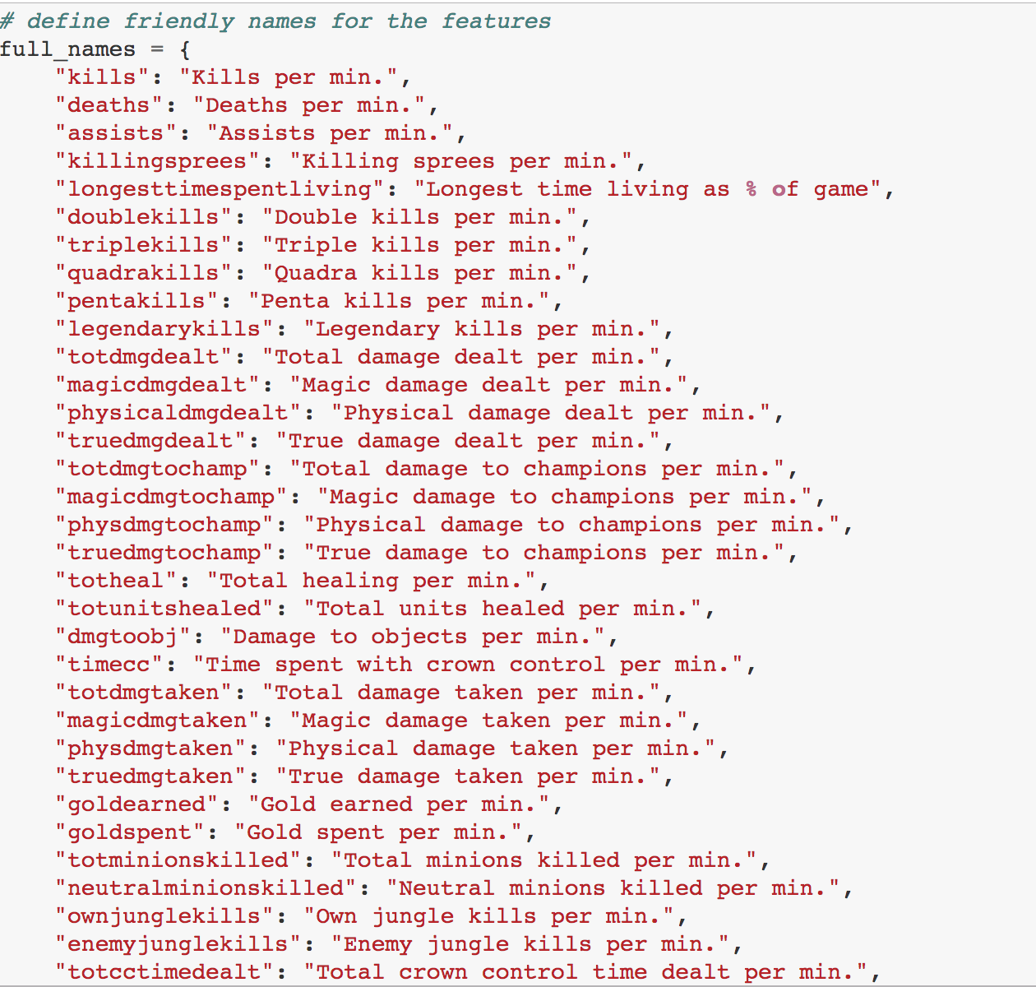
SHAP IN ACTION
Notes:
A really nice example of this is the League of Legends dataset example provided by the creators of Shap.
As a player or creator of a game, I might be interested in how all of these different variables correlate with the prediction I’m trying to make, e.g. winning a game of Legends. This model has lots of features as we can see.

Slide 10
SHAP IN ACTION
Notes:
By running SHAP over my model output, I can get a really nice summary of the impact of all feature across a dataset.
“A SHAP value for a feature of a specific prediction represents how much the model prediction changes when we observe that feature. In the summary plot below we plot all the SHAP values for a single feature (such as goldearned) on a row, where the x-axis is the SHAP value (which for this model is in units of log odds of winning). By doing this for all features, we see which features drive the model's prediction a lot (such as goldearned), and which only effect the prediction a little (such as kills). Note that when points don't fit together on the line they pile up vertically to show density. Each dot is also colored by the value of that feature from high to low.”

Slide 11
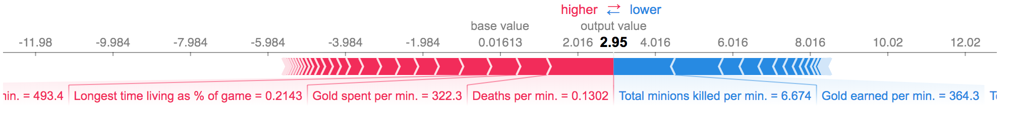
SHAP IN ACTION

Slide 12
SHAP IN ACTION
Notes:
I’m sure we can agree this is super powerful, but the SHAP library aims to explain the output of any machine learning model, beyond the typical regression & classification examples we’ve seen here. Here’s an example of it applied to a deep learning model…

Slide 13
EXPLAINABLE AI

Slide 14
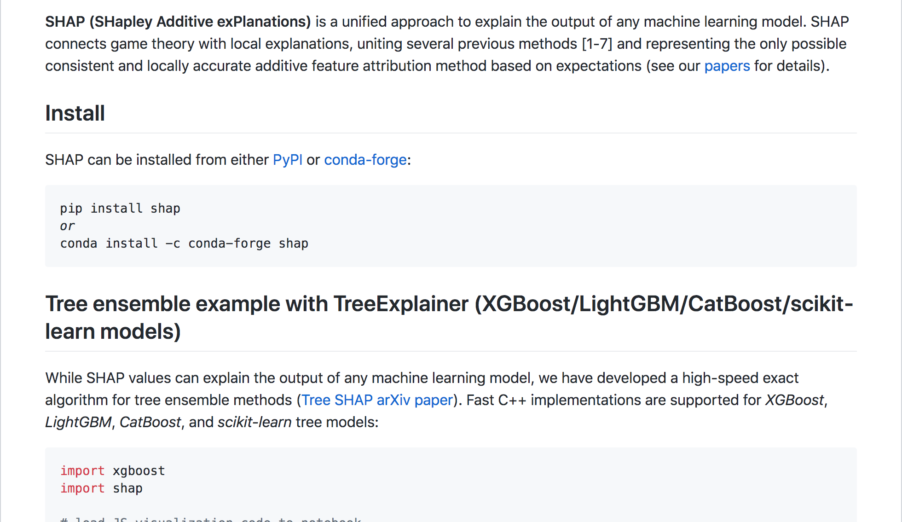
GETTING STARTED
Notes:
SHAP Is available in python and can be installed via the usual pip install or conda. It’s super easy to get started. Honestly it’s so intuitive!

Slide 15
conclusion
- Uses game theory to provide consistent and accurate explanations
Provides visually explainable model outputs
Intuitive for end users
Available in Python

